Slide 1
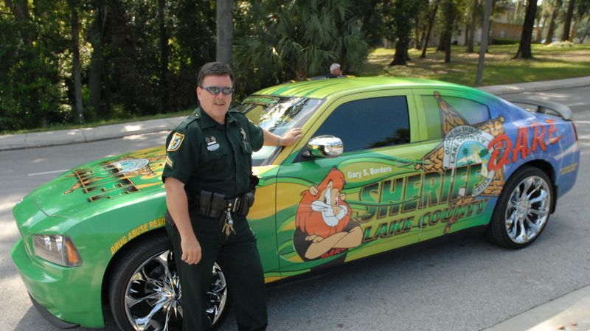
Drug Use as Deviance
Notes:
Police Officer by a D.A.R.E. car

Slide 2
Inquiry Spaces
What is there to know about drug use among individuals and groups in the society?
Aligned with a normative approach
How does the society “frame” and respond to drug use?
Aligned with the reactive approach
  Frame: perception, interpretation or communication about social phenomena

Slide 3
Normative and Reactive Approach (review)
Normative Approach: Deviance is the violation of widely held norms
  Norms have degrees of seriousness
  Focus is on rule breakers
  Deviance must be managed as a matter of social stability
Reactive Approach: Deviance is created when there is a negative evaluation or social response to attitudes, behaviors or characteristics
  Focus is on rule makers
  Deviant is a meaningful social status
  Deviant statuses are connected to social inequalities

Slide 4
Moral Panics: widespread fear or concern that there is a direct and immediate threat to the collective interest
Elements:
1) Group of persons identified as a threat and/or victim
2) Misrepresentation/distortion
﻿3) Oversimplification
﻿4) Urgency/call to action
﻿5) Organizational and institutional response

Slide 5
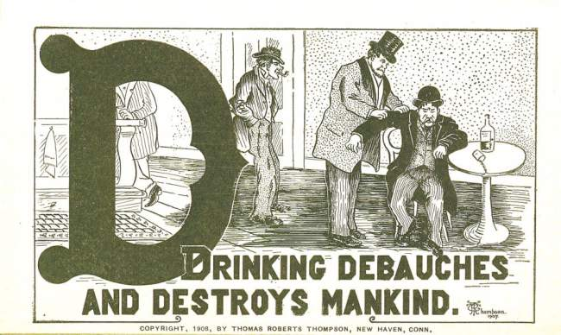

Slide 6
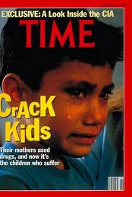
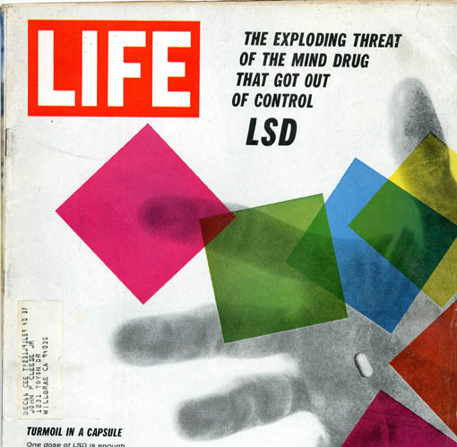
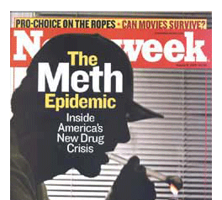

Slide 7
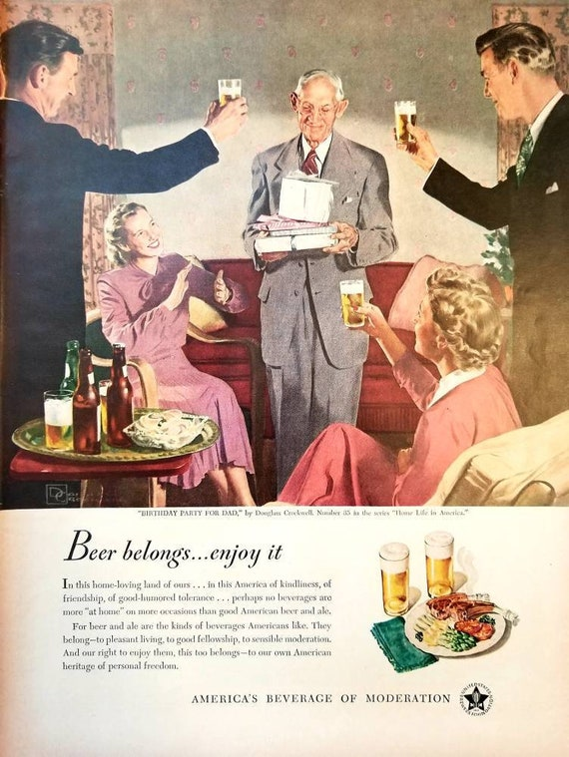
Why Study Alcohol?
Conventionality
Long use history
Familiarity
Declining use
Notes:
1949 ad

Slide 8
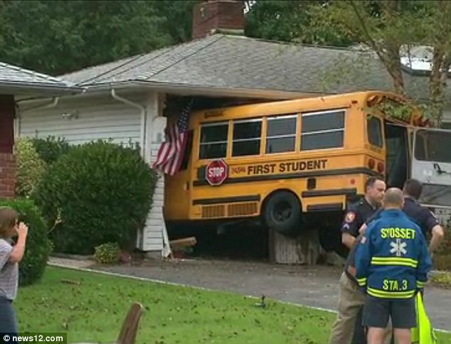
From conformity to deviance
Gets in the way of fulfilling social roles
When examined for comparative harms
Based on contingencies
When correlated with other forms of rule breaking

Slide 9
Explaining the co-occurrence of alcohol use and risk taking/rule breaking
Disinhibition: alcohol impairs perceptual and cognitive skills needed for decision making
Susceptibility: alcohol abuse and deviant behavior share a (third) common cause
Reciprocal: individuals wishing to engage in deviance use alcohol to reduce their inhibitions

Slide 10
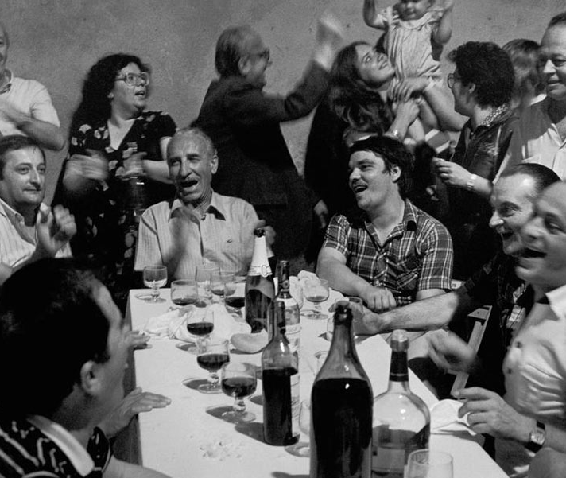
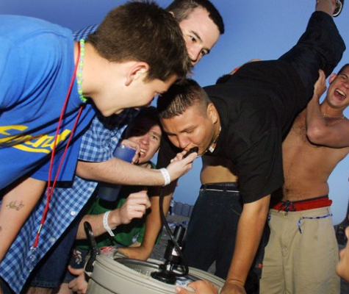
Drinking, Rule breaking, and Socio-Cultural Conditions: what, where and with who matters

Slide 11
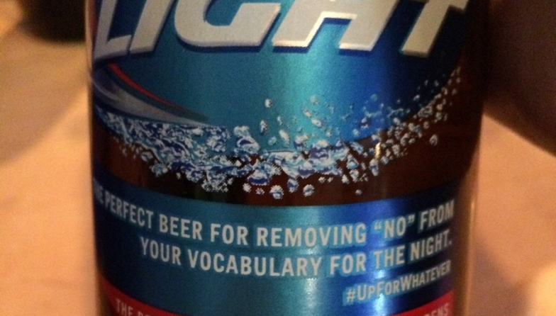
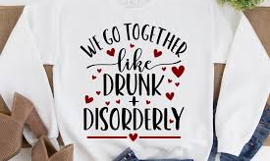
The Drunken Comportment

Slide 12
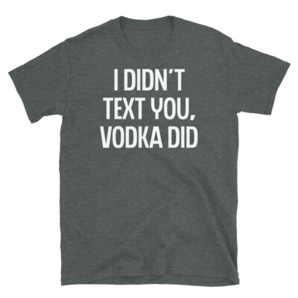
Drunken comportment: behavior that is culturally understood as “normative” for intoxicated people

Slide 13
Notes:
Bud light “up for whatever” campaign 2015

Slide 14
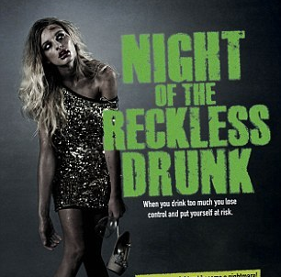
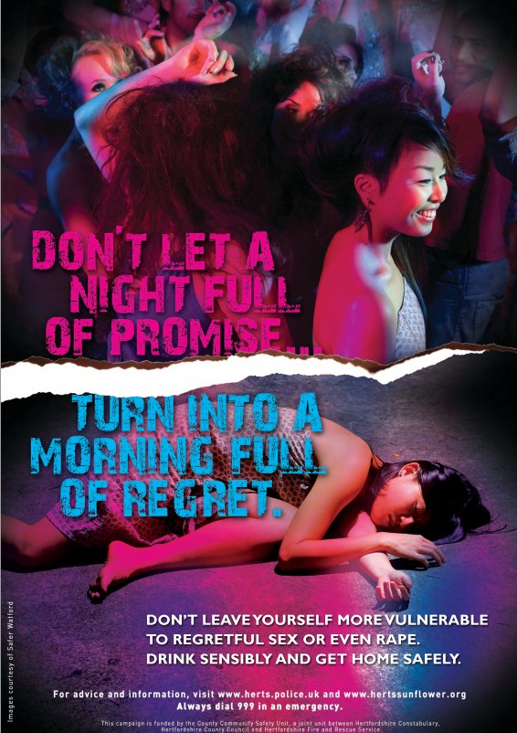
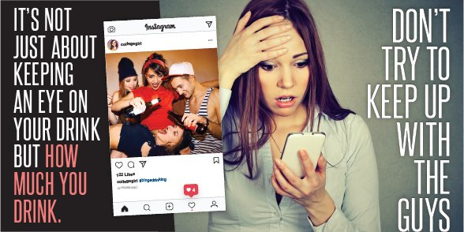
Notes:
Ist ad Calderdall Council, England, “promise” PSA: USA, Keep an eye on the drink New Zealand

Slide 15
Alcohol and Criminal Violence Connection
(correlation is not causation!)
Criminal Homicide: ~40%
Sexual Violence: ~37%
Intimate Partner Violence: ~65%
Child Abuse and Neglect: ~40%
Robbery/Burglary: ~12%
Notes:
Based on police incident logging, national victim surveys, and offender self-reporting, only required testing for homicides/DUIs

Slide 16
Alcohol, Criminal Violence and Perceptions of Victimization
Intoxicated people may be viewed and selected as vulnerable targets
Intoxicated people, when victimized, are more likely to be held responsible for their victimization
Mock Trials:
  SP/SV = outcome favorable to victim
  SP/IV = outcome more favorable to perpetrator
  IP/SV = outcome more favorable to perpetrator
  IP/IV = outcome more favorable to perpetrator
  S= Sober, P=Perpetrator, I=Intoxicated, V=Victim
Notes:
French and Munro

Slide 17
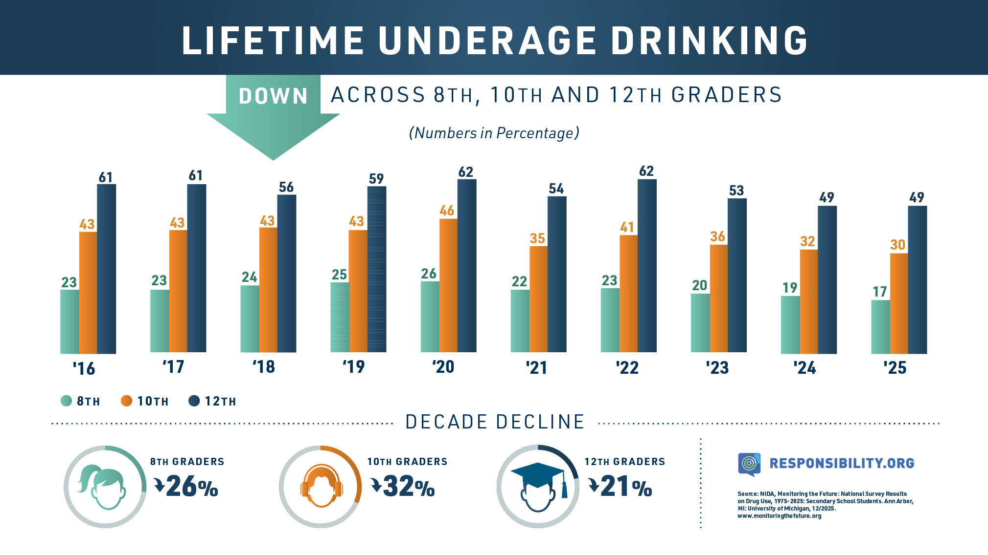
Alcohol Use in Decline
Notes:
First graph is consumed alcohol in last 30 days

Slide 18
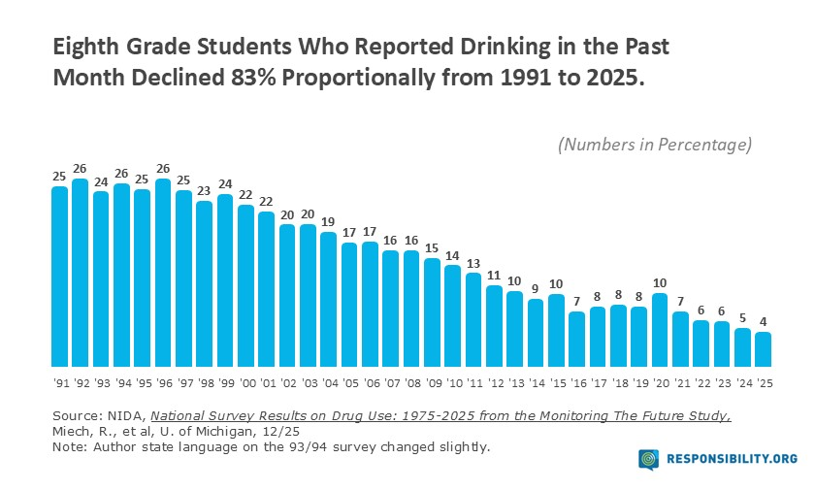

Slide 19
Explaining the Decline
Increased general social awareness of harm/risk
Social media influence focused on “wellness”
Increased educational campaigns that include alcohol
Less parental/familial use (socialization)
Policy changes
Displacement by other drugs (substitution effect)

